Slide 1
Understanding Basic Data Concepts

Slide 2
What is a data set?
A data set (sometimes referred to as data source, or database) in the context of Tableau, contains the data used to build visualizations.
Every bar chart, scatter plot, or line chart you see in Tableau has a connected database or spreadsheet that supplies the data.

Slide 3
Data Source types
Spreadsheets: A spreadsheet, such as Microsoft Excel or Google sheets, organizes data in a flat structure, which means the records are stored as single rows of data.
Relational databases: Relational databases store data in multiple tables, with each row assigned a unique identifier. Users pull data from different tables together using Structured Query Language (SQL). The "relational" aspect indicates a logical connection between different tables.
Cloud data: Sometimes, organizations prefer to store their data in the cloud so they do not have to support on-premises servers. This includes data stored in such places as Amazon Web Services or Microsoft Azure.
Other types of connections: Tableau also connects to spatial files for mapping, such as .kml or .shp, and statistical files created in R.

Slide 4

Connecting to Data with Tableau
Live connections vs. extracts : By default, Tableau maintains a live connection to your data. A live connection is a direct connection to your data, while a Tableau data extract is a compressed snapshot of data stored locally and loaded into memory.

Slide 5
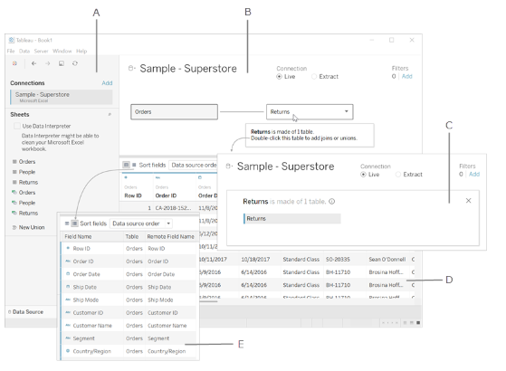
Explore connected data
The image below shows how the raw data in the Excel file maps to the information on the Data Source page.

Slide 6
Cont…
A. Left pane - Displays the connected data source and other details about your data.
B. Canvas: logical layer - The canvas opens with the logical layer, where you can create relationships between logical tables.
C. Canvas: physical layer - Double-click a table in the logical layer to go to the physical layer of the canvas, where you can add joins and unions between tables.
D. Data grid - Displays first 1,000 rows of the data contained in the Tableau data source.
E. Metadata grid - Displays the fields in your data source as rows

Slide 7
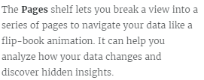
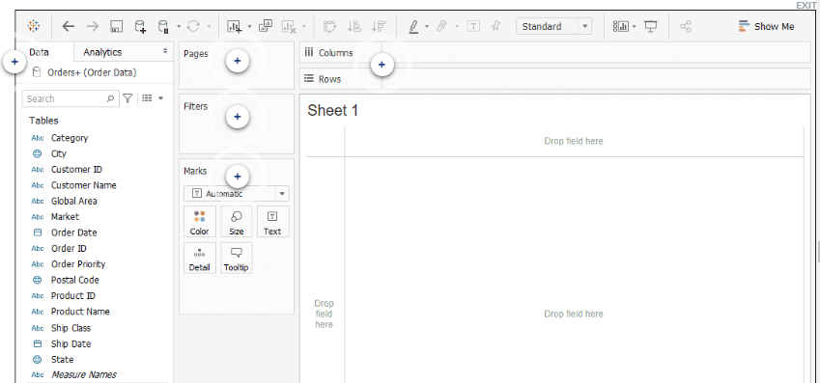
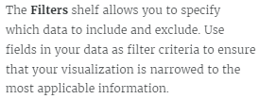
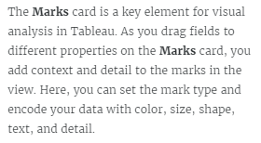
Data Workspace
Data Pane: Variety of fields organised by tables
Column & Row shelves

Slide 8
1. Which area of the Tableau workspace displays the data source name and its available fields as dimensions and measures?
Pages shelf
Marks card
Data pane
Filters shelf
2. Where on the Data Source page would you drag a table that you want to add to your visualization?
Preview area
Data pane
Canvas
Connection area

